Slide 1
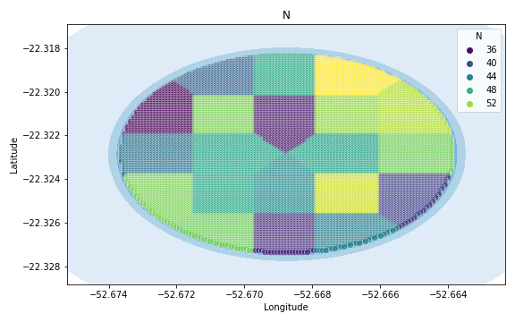
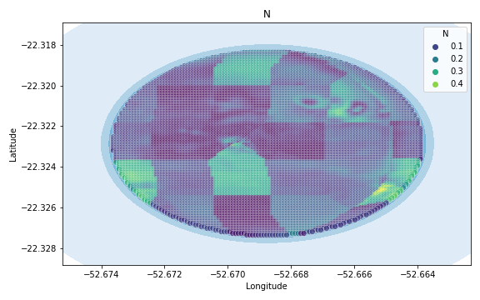
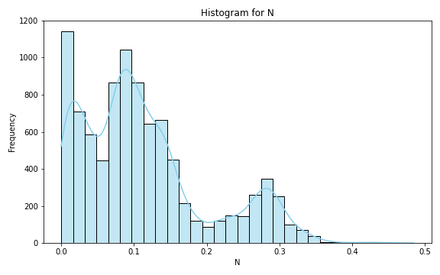
Analysis for column: N Model: Random Forest
Statistics:
mean 1.049212e-01
std 8.815087e-02
min 1.635520e-15
25% 3.648061e-02
50% 8.422585e-02
75% 1.442681e-01
80% 1.639094e-01
85% 1.940669e-01
90% 2.383233e-01
95% 2.958638e-01
99% 3.710783e-01

Slide 2
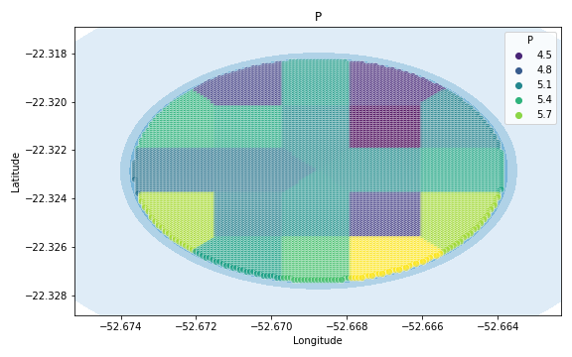
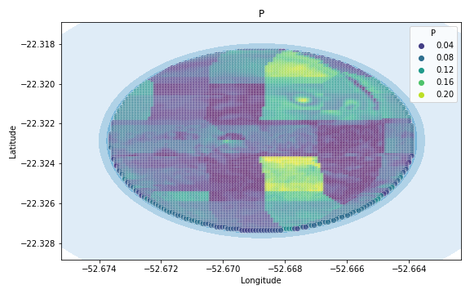
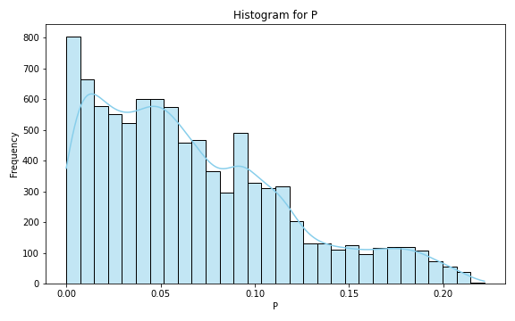
Analysis for column: P Model: Random Forest
Statistics:
mean 6.174843e-02
std 5.316577e-02
min 9.251859e-16
25% 2.038128e-02
50% 4.578495e-02
75% 9.174194e-02
80% 1.057429e-01
85% 1.211117e-01
90% 1.395552e-01
95% 1.662882e-01
99% 2.148296e-01

Slide 3
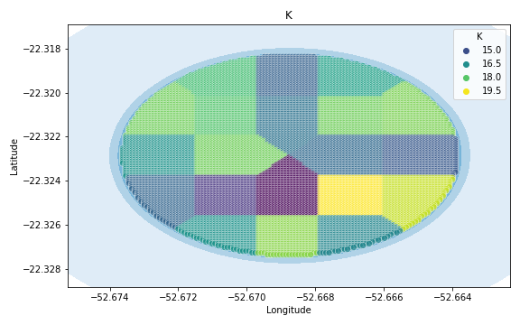
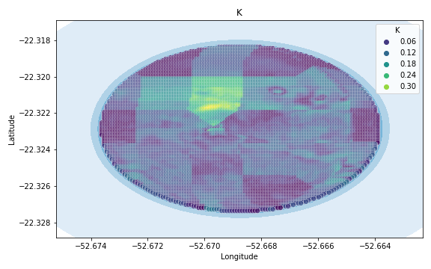
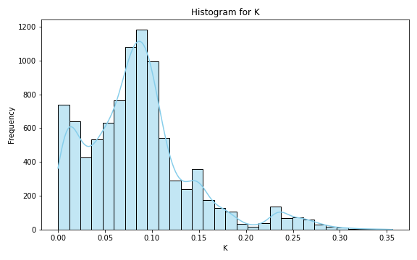
Analysis for column: K Model: Random Forest
Statistics:
mean 8.197825e-02
std 6.616079e-02
min 4.563537e-16
25% 3.291116e-02
50% 6.788862e-02
75% 1.141698e-01
80% 1.271756e-01
85% 1.428384e-01
90% 1.637036e-01
95% 2.064796e-01
99% 3.200254e-01

Slide 4
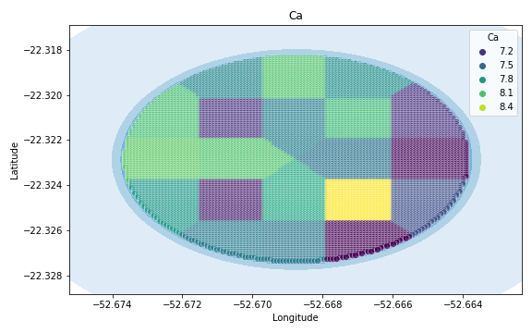
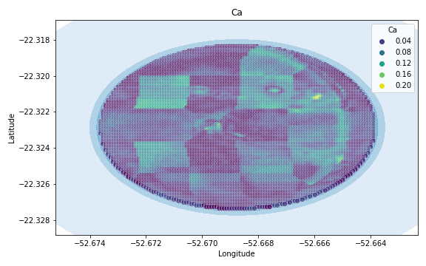
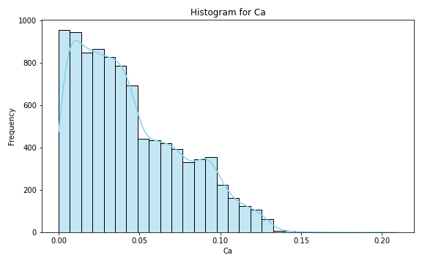
Analysis for column: Ca Model: Random Forest
Statistics:
mean 4.188505e-02
std 3.324579e-02
min 8.793846e-16
25% 1.459355e-02
50% 3.386503e-02
75% 6.267525e-02
80% 7.057225e-02
85% 7.925369e-02
90% 9.180597e-02
95% 1.084305e-01
99% 1.315882e-01

Slide 5
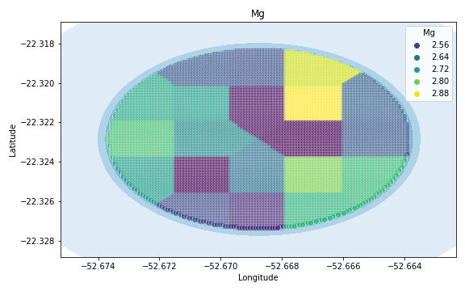
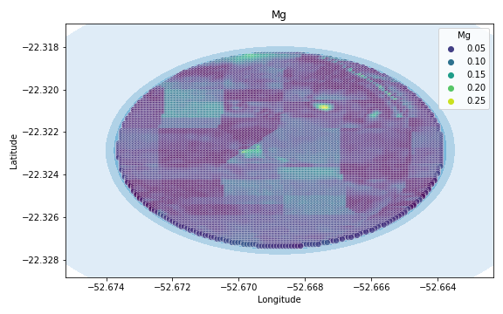
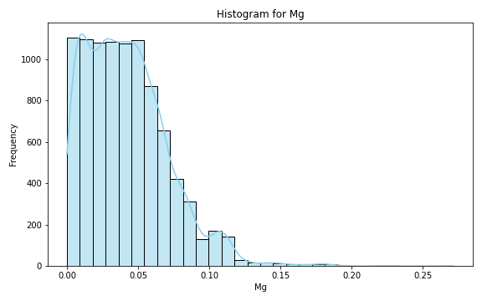
Analysis for column: Mg Model: Random Forest
Statistics:
mean 3.532909e-02
std 2.604352e-02
min 4.916117e-16
25% 1.394834e-02
50% 3.068273e-02
75% 5.189091e-02
80% 5.716105e-02
85% 6.302761e-02
90% 7.196000e-02
95% 8.499764e-02
99% 1.057959e-01

Slide 6
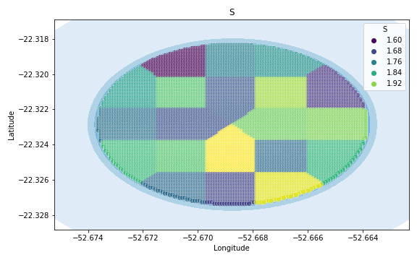
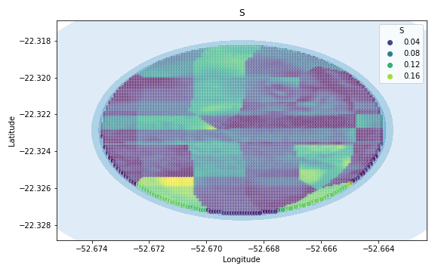
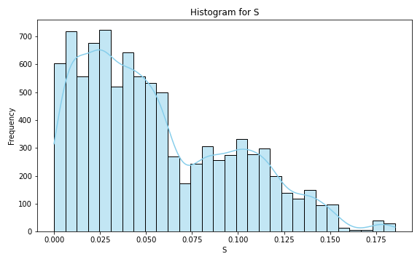
Analysis for column: S Model: Random Forest
Statistics:
mean 5.409621e-02
std 3.881834e-02
min 3.784851e-16
25% 2.352601e-02
50% 4.739362e-02
75% 7.494118e-02
80% 8.287043e-02
85% 9.470615e-02
90% 1.102385e-01
95% 1.315094e-01
99% 1.633686e-01

Slide 7
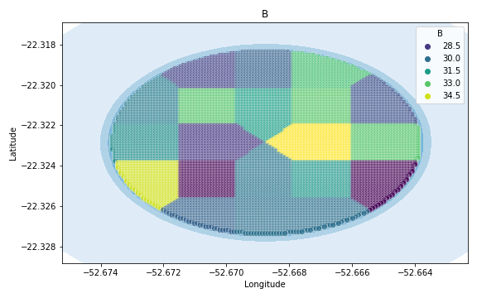
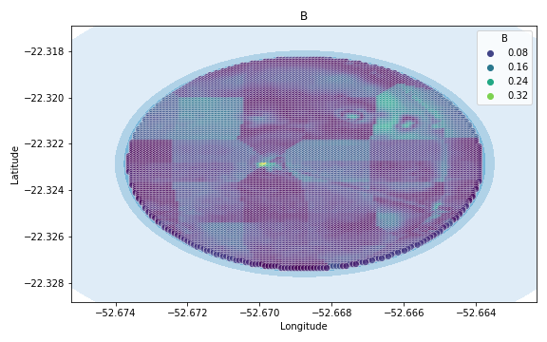
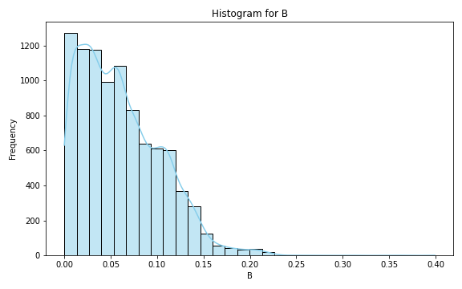
Analysis for column: B Model: Random Forest
Statistics:
mean 0.056487
std 0.041433
min 0.000003
25% 0.022384
50% 0.048390
75% 0.083493
80% 0.092662
85% 0.102045
90% 0.115210
95% 0.132989
99% 0.175840

Slide 8
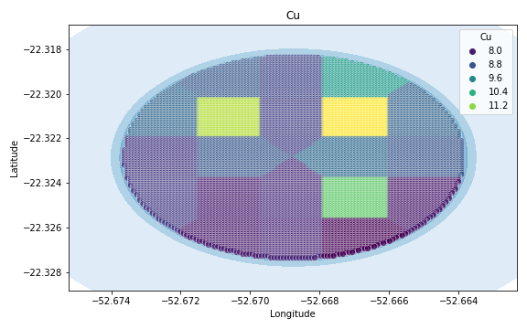
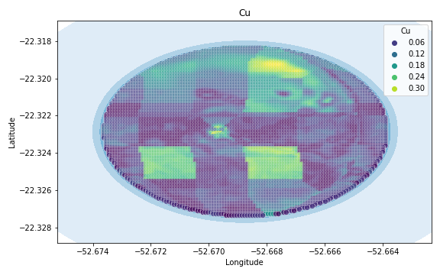
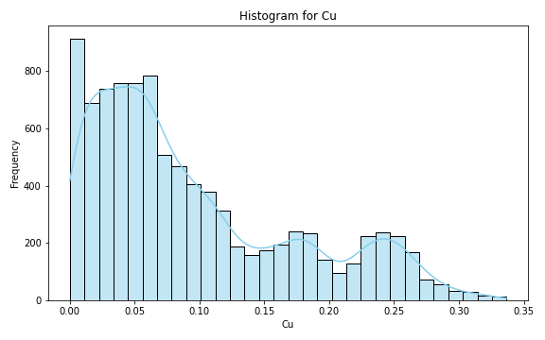
Analysis for column: Cu Model: Random Forest
Statistics:
mean 9.093581e-02
std 7.534313e-02
min 2.385827e-15
25% 2.954762e-02
50% 7.063754e-02
75% 1.377386e-01
80% 1.590751e-01
85% 1.814085e-01
90% 2.086445e-01
95% 2.396397e-01
99% 2.868966e-01

Slide 9
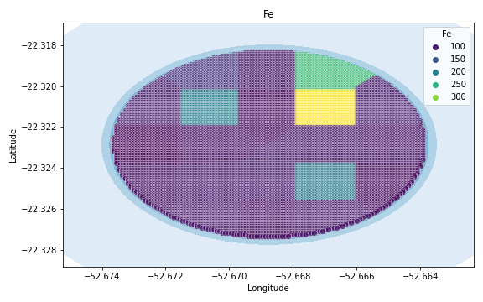
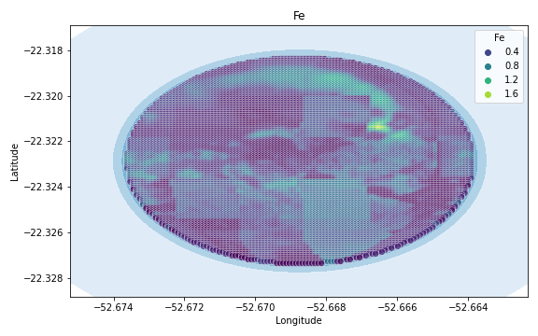
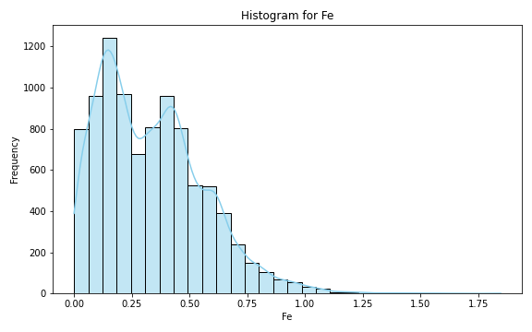
Analysis for column: Fe Model: Random Forest
Statistics:
mean 0.308553
std 0.332029
min 0.000053
25% 0.066814
50% 0.207953
75% 0.450988
80% 0.504167
85% 0.579547
90% 0.680791
95% 0.899198
99% 1.603354

Slide 10
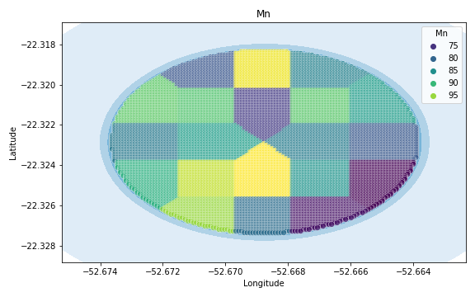
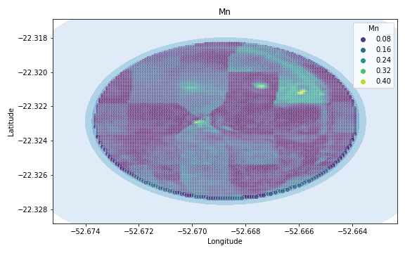
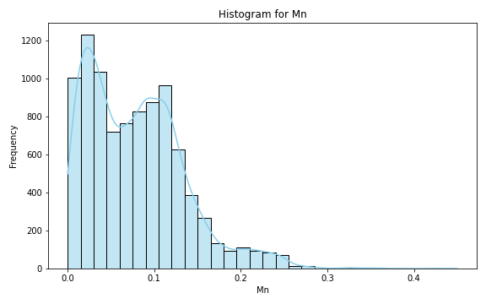
Analysis for column: Mn Model: Random Forest
Statistics:
mean 0.072785
std 0.052348
min 0.000025
25% 0.030690
50% 0.065225
75% 0.104435
80% 0.114098
85% 0.127072
90% 0.142654
95% 0.171598
99% 0.226821

Slide 11
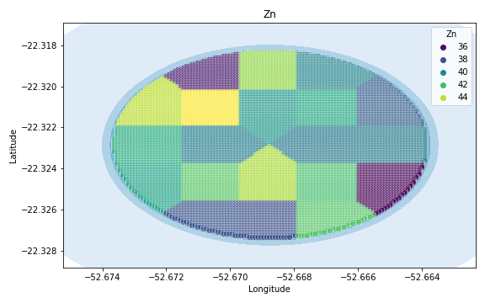
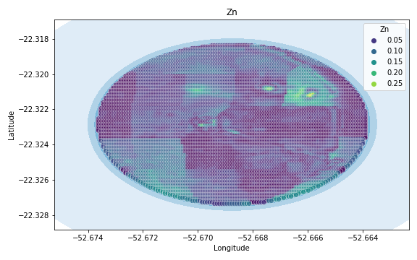
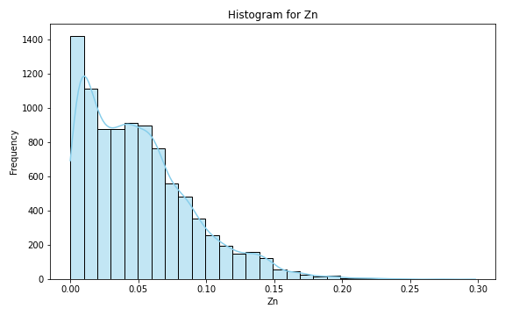
Analysis for column: Zn Model: Random Forest
Statistics:
mean 4.804796e-02
std 3.958969e-02
min 1.296611e-15
25% 1.629686e-02
50% 3.959834e-02
75% 6.874001e-02
80% 7.706625e-02
85% 8.981424e-02
90% 1.049291e-01
95% 1.269421e-01
99% 1.721403e-01

Slide 12
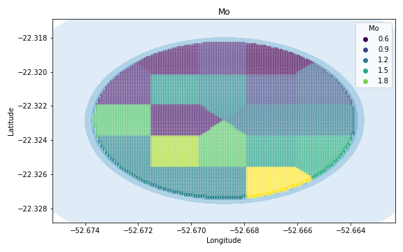
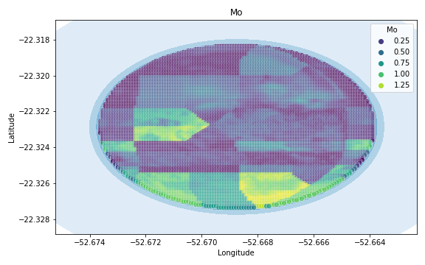
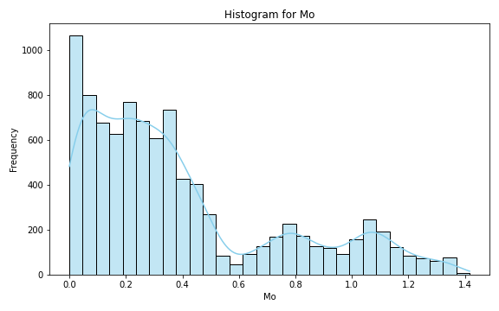
Analysis for column: Mo Model: Random Forest
Statistics:
mean 3.265162e-01
std 3.274825e-01
min 2.921640e-16
25% 9.000000e-02
50% 2.155556e-01
75% 4.374257e-01
80% 5.345493e-01
85% 6.658279e-01
90% 8.346361e-01
95% 1.028529e+00
99% 1.372293e+00

Slide 13
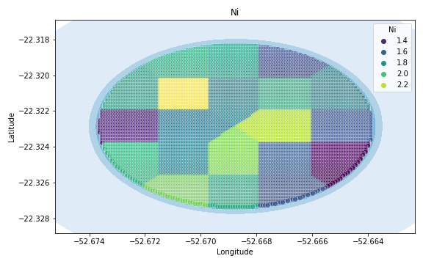
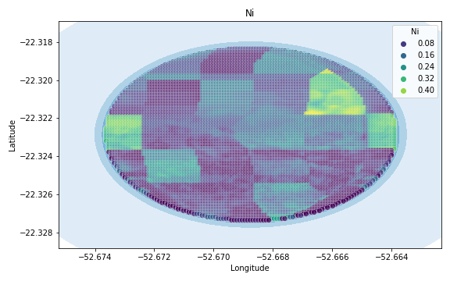
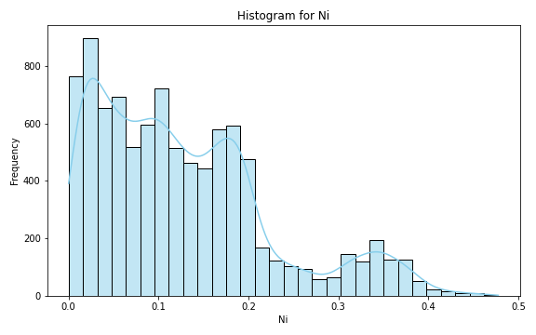
Analysis for column: Ni Model: Random Forest
Statistics:
mean 1.150411e-01
std 9.746752e-02
min 2.883696e-16
25% 3.982659e-02
50% 9.042857e-02
75% 1.637013e-01
80% 1.852937e-01
85% 2.140574e-01
90% 2.494381e-01
95% 3.104021e-01
99% 4.282451e-01

Slide 14
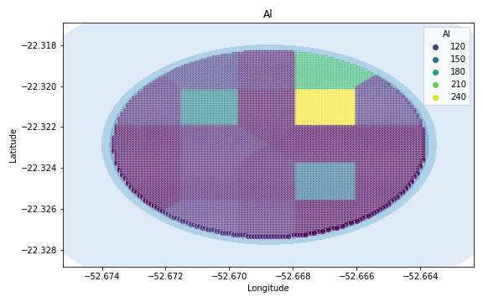
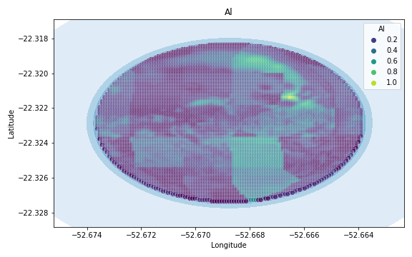
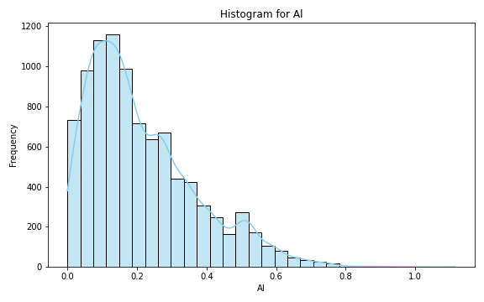
Analysis for column: Al Model: Random Forest
Statistics:
mean 0.196730
std 0.194526
min 0.000063
25% 0.058276
50% 0.135837
75% 0.282135
80% 0.321476
85% 0.370808
90% 0.442567
95% 0.558774
99% 0.925689

Slide 15
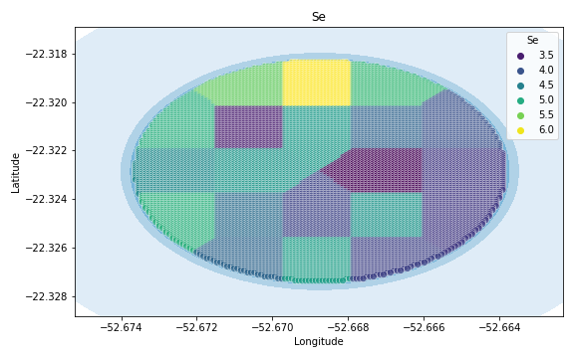
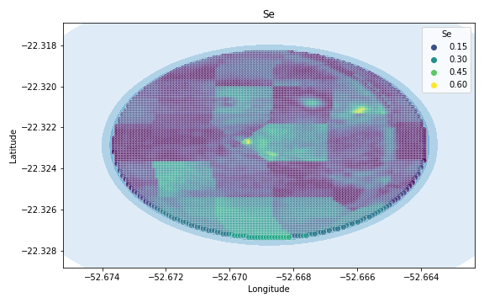
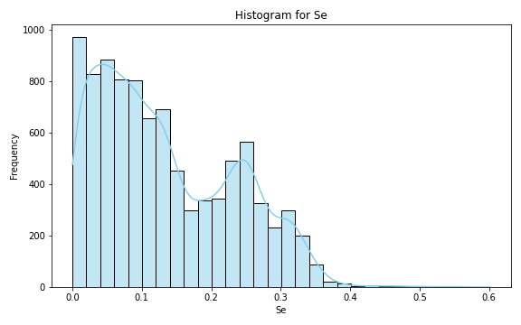
Analysis for column: Se Model: Random Forest
Statistics:
mean 1.228321e-01
std 9.921888e-02
min 1.299197e-15
25% 4.321429e-02
50% 9.647525e-02
75% 1.851667e-01
80% 2.067860e-01
85% 2.302910e-01
90% 2.614327e-01
95% 3.147915e-01
99% 4.203145e-01

Slide 16
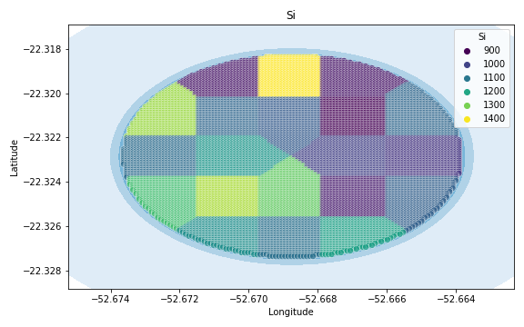
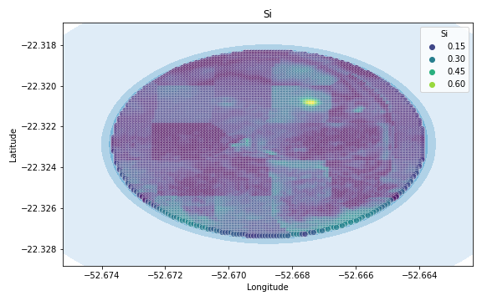
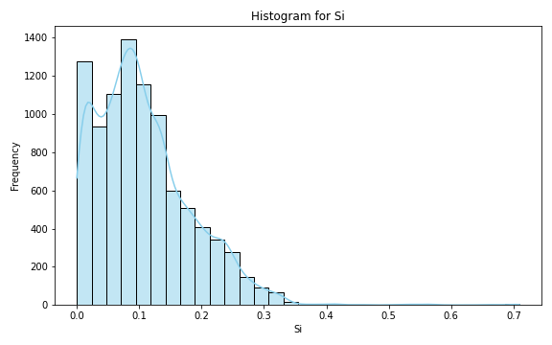
Analysis for column: Si Model: Random Forest
Statistics:
mean 9.901349e-02
std 7.673431e-02
min 1.725044e-15
25% 3.932891e-02
50% 8.498937e-02
75% 1.403688e-01
80% 1.533364e-01
85% 1.701839e-01
90% 1.969697e-01
95% 2.468091e-01
99% 3.606043e-01

Slide 17
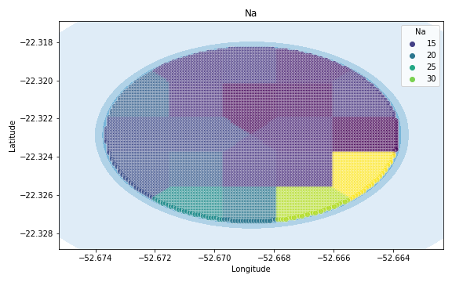
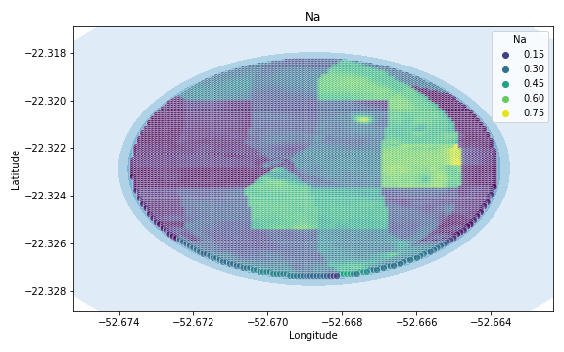

Analysis for column: Na Model: Random Forest
Statistics:
mean 2.508936e-01
std 2.718114e-01
min 2.240817e-15
25% 7.028338e-02
50% 1.690696e-01
75% 3.411907e-01
80% 3.889359e-01
85% 4.649383e-01
90% 5.577328e-01
95% 7.123889e-01
99% 1.433666e+00

Slide 18



Analysis for column: Va Model: Random Forest
Statistics:
mean 5.229208e-01
std 6.452626e-01
min 3.700743e-16
25% 1.500000e-01
50% 3.359155e-01
75% 6.352113e-01
80% 7.207665e-01
85% 8.548889e-01
90% 1.161543e+00
95% 1.695029e+00
99% 3.296686e+00

Slide 19



Analysis for column: DRIS_N Model: Random Forest
Statistics:
mean inf
std NaN
min 2.105595e-15
25% 3.390476e-01
50% 7.192405e-01
75% 2.432857e+00
80% 3.391667e+00
85% 4.728857e+00
90% 7.916000e+00
95% 4.868800e+01
99% NaN

Slide 20



Analysis for column: DRIS_P Model: Random Forest
Statistics:
mean 3.828507e-01
std 6.886607e-01
min 1.248444e-15
25% 6.502538e-02
50% 1.461290e-01
75% 3.272691e-01
80% 4.320504e-01
85% 6.547963e-01
90% 9.693946e-01
95% 1.649128e+00
99% 3.796330e+00

Slide 21



Analysis for column: DRIS_K Model: Random Forest
Statistics:
mean 3.872806e+00
std 1.429473e+01
min 9.251859e-16
25% 4.171622e-01
50% 7.919048e-01
75% 1.703571e+00
80% 2.310736e+00
85% 3.185220e+00
90% 4.763128e+00
95% 1.569400e+01
99% 6.568680e+01

Slide 22



Analysis for column: DRIS_Ca Model: Random Forest
Statistics:
mean 1.608657e+00
std 4.204661e+00
min 5.551115e-16
25% 2.036066e-01
50% 4.621739e-01
75% 9.924242e-01
80% 1.421584e+00
85% 2.006152e+00
90% 2.903766e+00
95% 6.852182e+00
99% 2.165760e+01

Slide 23



Analysis for column: DRIS_Mg Model: Random Forest
Statistics:
mean 1.715644e+00
std 3.777778e+00
min 2.775558e-16
25% 2.400000e-01
50% 5.106250e-01
75% 1.005909e+00
80% 1.215642e+00
85% 1.983409e+00
90% 4.495000e+00
95% 9.666000e+00
99% 1.995120e+01

Slide 24



Analysis for column: DRIS_S Model: Random Forest
Statistics:
mean 8.528308e-01
std 2.503733e+00
min 1.471380e-15
25% 1.200000e-01
50% 2.775904e-01
75% 4.957303e-01
80% 5.523084e-01
85% 6.424706e-01
90% 8.841987e-01
95% 1.783698e+00
99% 1.407822e+01

Slide 25



Analysis for column: DRIS_B Model: Random Forest
Statistics:
mean 1.401254
std 3.690317
min 0.000114
25% 0.166981
50% 0.358909
75% 0.823810
80% 1.205619
85% 1.686217
90% 2.416609
95% 6.030000
99% 20.527333

Slide 26



Analysis for column: DRIS_Cu Model: Random Forest
Statistics:
mean 0.416084
std 1.342165
min 0.000000
25% 0.049819
50% 0.112020
75% 0.206503
80% 0.239125
85% 0.283267
90% 0.359522
95% 0.589382
99% 7.490852

Slide 27



Analysis for column: DRIS_Fe Model: Random Forest
Statistics:
mean 1.028209
std 1.302301
min 0.000101
25% 0.224037
50% 0.615931
75% 1.313662
80% 1.592247
85% 1.966463
90% 2.503016
95% 3.551202
99% 6.416182

Slide 28



Analysis for column: DRIS_Mn Model: Random Forest
Statistics:
mean 2.956832e-01
std 5.305014e-01
min 1.805241e-16
25% 6.412429e-02
50% 1.559459e-01
75% 2.846328e-01
80% 3.257388e-01
85% 3.806023e-01
90% 4.953016e-01
95% 9.780160e-01
99% 3.024873e+00

Slide 29



Analysis for column: DRIS_Zn Model: Random Forest
Statistics:
mean 7.401845e-01
std 1.502868e+00
min 4.111937e-16
25% 1.182813e-01
50% 2.598718e-01
75% 6.069231e-01
80% 8.173096e-01
85% 1.180372e+00
90% 1.696000e+00
95% 3.223714e+00
99% 8.502171e+00

Slide 30



Analysis for column: IMS Model: Random Forest
Statistics:
mean 1.273028e+00
std 3.085130e+00
min 2.176908e-16
25% 8.895833e-02
50% 2.283929e-01
75% 7.562687e-01
80% 1.131284e+00
85% 2.388333e+00
90% 3.290000e+00
95% 5.699000e+00
99% 1.534373e+01

Slide 31



Analysis for column: IBN Model: Random Forest
Statistics:
mean 5.206315e-01
std 1.776689e+00
min 2.909675e-16
25% 5.066498e-02
50% 1.133267e-01
75% 2.300760e-01
80% 2.720024e-01
85% 3.245242e-01
90% 4.176877e-01
95% 7.334620e-01
99% 9.554753e+00

